Slide 1
PJM Hourly Energy Consumption Forecasting
XGBoost & SARIMAX Based 30-Day Forecasting
Data analysis • Forecasting • Model evaluation • Streamlit deployment
Forecast horizon
30 Days
Forecast points
720 Hours
Models
XGBoost + SARIMAX
Target
PJM MW
1

Slide 2
Mentor & Team Members
Submission details
Mentor: MR.Karthik
Team Members:
• Prem Kiran Boda
• Piyush Ranjan Srivastava
• Sayooj Chandran P
• Siddartha V N
• Sharangouda Patil
2

Slide 3
Project Objective
Analyze historical PJM hourly electricity consumption.
Identify time-based, weekly, seasonal and holiday demand patterns.
Build forecasting models capable of predicting the next 30 days.
Compare machine-learning and seasonal time-series approaches.
Present the forecasts through an interactive Streamlit application.
3

Slide 4
Dataset Details
Rows
143,206
Columns
2
Target
PJMW_MW
Mean Demand
5,602.38 MW
Time range: April 2002 to August 2018.
Datetime is the hourly time index; PJMW_MW is electricity consumption.
No missing values were found in the original dataset.
No fully duplicated rows were found.
The dataset provides enough historical depth to study recurring demand patterns.
4

Slide 5
EDA — Data Quality & Preparation
Datetime was converted to a proper time-series index and sorted chronologically.
Time-based features were derived to study hour, day, month, year, season and weekend effects.
Holiday status was identified using the U.S. holiday calendar.
The cleaned time series was used for chronological forecasting evaluation.
The analysis focused on patterns that could explain changes in hourly electricity demand.
5

Slide 6
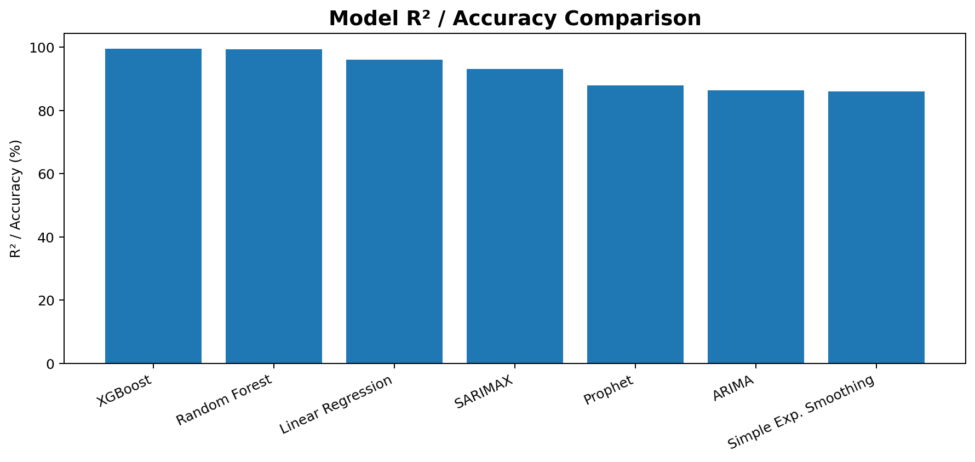
EDA — Long-Term Consumption Pattern
Electricity demand changes substantially across the full historical period.
The series shows both recurring seasonal behavior and longer-term variation.
Demand is not constant, so a forecasting model must account for time dependence.
The long historical record provides useful context for model training and evaluation.
6

Slide 7
EDA — Hourly Demand Pattern
Consumption varies clearly by hour of the day.
Demand tends to rise during active daytime and evening periods.
The presence of a repeating daily pattern supports a 24-hour seasonal component.
This pattern is especially relevant to SARIMAX seasonal modeling.
Lowest average hour
04:00
Highest average hour
19:00
Peak seasonal demand
Evening
Seasonal period
24 hours
7

Slide 8
EDA — Weekday vs Weekend
Weekdays and weekends follow different consumption profiles.
Weekday demand is generally higher than weekend demand.
The difference indicates that human activity and working schedules influence electricity usage.
Weekend behavior is therefore an important contextual signal for machine-learning features.
Weekday average
5,754.35 MW
Weekend average
5,221.86 MW
Difference
≈ 532.49 MW
8

Slide 9
EDA — Monthly & Seasonal Behavior
Monthly demand varies across the year rather than remaining flat.
Winter shows the highest average seasonal consumption.
Autumn and spring have comparatively lower average demand.
Seasonality confirms that time-of-year information is relevant to forecasting.
Winter average
6,268.81 MW
Summer average
5,734.21 MW
Spring average
5,224.39 MW
Autumn average
5,200.14 MW
9

Slide 10
EDA — Season × Hour Relationship
Hourly demand profiles are not identical across seasons.
Summer and winter have different peak timing and intensity.
Winter shows a stronger evening peak, while summer also shows high late-day demand.
The interaction between season and hour supports richer feature engineering for XGBoost.
10

Slide 11
EDA — Holiday & Outlier Insights
Holiday demand is lower on average than non-holiday demand.
This suggests that special-day activity changes electricity usage.
The historical distribution contains a small number of unusually high or low observations.
Extreme values should be monitored because they can increase forecasting error.
Holiday average
5,476.77 MW
Non-holiday average
5,606.28 MW
Observed maximum
9,594 MW
11

Slide 12
Feature Engineering for XGBoost
Calendar features: year, month, day, hour and day of week.
Behavioral features: weekend and holiday indicators.
Lag features: previous hour, previous day and previous week.
These features allow XGBoost to learn both calendar effects and recent demand relationships.
The recursive forecast later updates lag values with its own predictions.
12

Slide 13
Modeling Strategy
Two final approaches were emphasized: XGBoost and SARIMAX.
XGBoost represents a feature-driven machine-learning approach.
SARIMAX represents a seasonal time-series approach with a 24-hour cycle.
Models were evaluated using forecasting error metrics such as MAE, RMSE and MAPE, with R² used for model comparison.
The final deployment keeps both models available for comparison.
13

Slide 14
SARIMAX — Model Design
Model: SARIMAX(2,0,1) × (1,1,1,24).
The 24-hour seasonal period captures repeating daily electricity-demand structure.
Training window: 8,641 hours beginning 01-Aug-2017.
The model forecasts directly from its estimated seasonal time-series state.
The latest 168 hours were incorporated through state updating before the 30-day forecast.
14

Slide 15
XGBoost — Model Design
XGBoost Regressor was trained using time and lag-based features.
The model learns nonlinear relationships between calendar context and previous demand.
The feature set includes previous-hour, previous-day and previous-week demand.
For future forecasting, unknown lag values are handled recursively.
Each predicted hour becomes available as an input for later forecast steps.
15

Slide 16
Model Comparison — R² / Accuracy
XGBoost achieved the highest reported R² at 99.46%, closely followed by Random Forest at 99.43%.
SARIMAX achieved 93.17% on the reported evaluation.
16

Slide 17
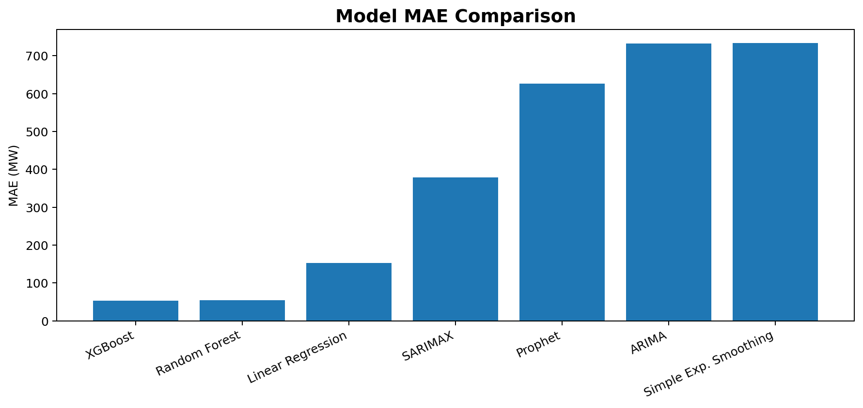
Model Comparison — MAE
XGBoost produced the lowest reported MAE among the compared models.
SARIMAX showed substantially higher error than the tree-based models but remained stronger than the other classical baselines in the reported comparison.
17

Slide 18
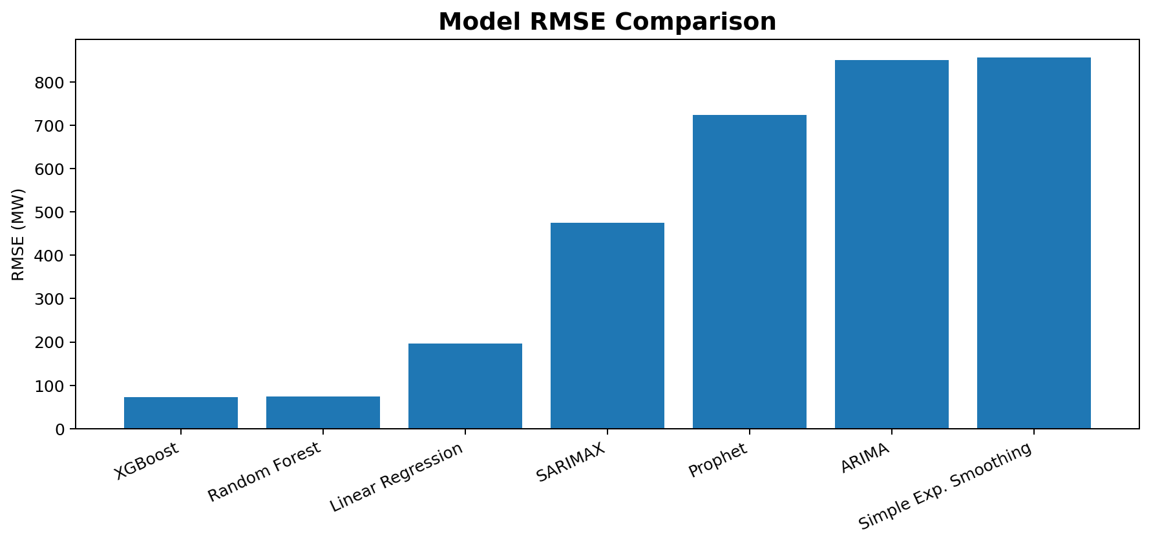
Model Comparison — RMSE
XGBoost achieved the lowest reported RMSE, indicating fewer large prediction errors in its evaluation split.
SARIMAX RMSE was 475.4 MW on the last-7-day hold-out.
18

Slide 19
Final Model Evaluation — SARIMAX
MAE
379.38 MW
RMSE
475.35 MW
MAPE
6.83%
R²
68.26%
Evaluation: last 7 days / 168-hour hold-out.
SARIMAX captured the repeating daily structure and produced a stable multi-step forecast.
The hold-out results show that the model can explain a meaningful share of demand variation, while remaining sensitive to demand changes not captured by the seasonal structure.
19

Slide 20
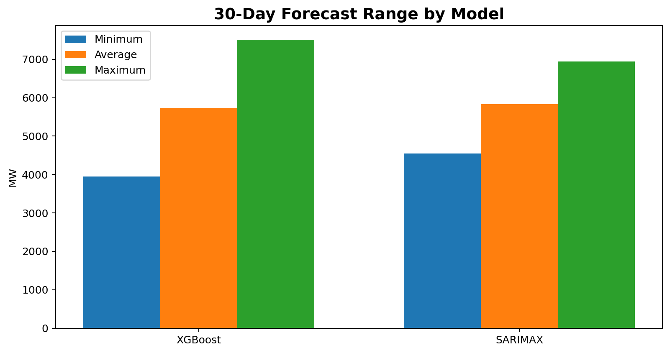
30-Day Forecast — XGBoost
Forecast hours
720
Forecast days
30
Average MW
5,729.06
Maximum MW
7,503.34
Minimum MW
3,944.14
20

Slide 21
30-Day Forecast — SARIMAX
Forecast hours
720
Forecast days
30
Average MW
5,828.84
Maximum MW
6,947.30
Minimum MW
4,542.55
The SARIMAX forecast remains within a narrower range than XGBoost.
Its daily seasonal structure produces a smooth, repeatable demand profile across the 30-day horizon.
21

Slide 22
Forecast Comparison & Interpretation
XGBoost forecasts a wider demand range: 3,944–7,503 MW.
SARIMAX forecasts a narrower range: 4,543–6,947 MW.
XGBoost can capture nonlinear relationships from calendar and lag features.
SARIMAX emphasizes the recurring 24-hour seasonal structure.
Using both models provides a useful comparison between feature-driven and classical seasonal forecasting.
22

Slide 23
Streamlit App — Dashboard Page
App preview based on the implemented deployment layout
⚡ PJM Energy
Forecast
Hours
720
Days
30
Avg MW
5,729
Max MW
7,503
Min
3,944
Model: XGBoost / SARIMAX
Overview
Model Performance
30-Day Forecast
Forecast Data
Interactive model selector
Forecast summary
Hourly and daily forecast views
Downloadable forecast data
23

Slide 24
Challenges Faced During the Project
Handling a large hourly time series while preserving chronological order.
Understanding and separating daily, weekly, seasonal and holiday demand effects.
Choosing suitable model structures for a strong 24-hour seasonal pattern.
Generating a 30-day XGBoost forecast when future lag values are unavailable.
Comparing machine-learning and time-series models using meaningful evaluation metrics.
Preparing the forecasting outputs for an interactive Streamlit application.
24

Slide 25
Thank You
Questions & Discussion
PJM Hourly Energy Consumption Forecasting
25

